Slide 1
Horace : Ars Poetica (the Art of Poetry) lines 240 – 242
ex noto fictum carmen sequar, ut sibi quivis
speret idem, sudet multum frustraque laboret
ausus idem :
I will aim for poetry moulded from the familiar so that if anyone
wants the same for himself, he may sweat a lot and work in vain
trying the same thing :
tantum series iuncturaque pollet
the order and combination (of words) has such great power.

Slide 2
Latin does not rely on word-order to convey meaning: as an inflected language, the words change their endings depending on the sense of the sentence, so they can be placed in the order the poet thinks is most effective ….

Slide 3
Horace : Ars Poetica (the Art of Poetry) line 361
ut pictura poesis
Poetry is like a picture ………

Slide 4
nullo munuscula cultu
errantes hederas passim cum baccare tellus
mixtaque ridenti colocasia fundet acantho
Virgil, Eclogue IV lines 18 – 20
Virgil describes the profusion of flowers growing together in the Golden Age.

Slide 5
A translation of these lines is :
With no cultivation
nullo cultu
the earth pours forth its little gifts :
tellus .. fundet .. munuscula
climbing ivy everywhere with cyclamen
errantes hederas passim cum baccare
and colocasia mixed
colocasia .. mixtaque
with smiling acanthus.
ridenti .. acantho.

Slide 6

Virgil has mixed up the order of the words to illustrate the mixed flowers:
mixta goes with colocasia and ridenti goes with acantho

Slide 7
Horace, Satire II 6, parts of lines 79 - 81
rusticus urbanum murem mus
veterem vetus hospes amicum
[Once upon a time], the Country Mouse [is said to have invited into his poor mousehole] the Town Mouse, an old friend [welcoming] his old friend.
Horace describes the Country Mouse greeting his old friend the Town Mouse – but you can see that he has ‘unpoetically’ used the same words for ‘mouse’ (mus/murem) and ‘old’ (vetus/veterem) next to each other.
‘hospes’ and ‘amicum’ both mean ‘friend’ – but at least here Horace has varied his vocabulary.
Very odd ….

Slide 8
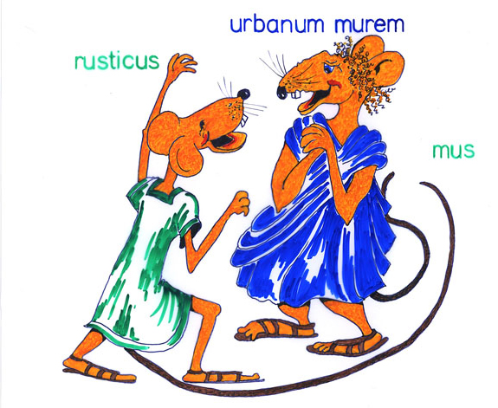
The country mouse is embracing his friend.

Slide 9
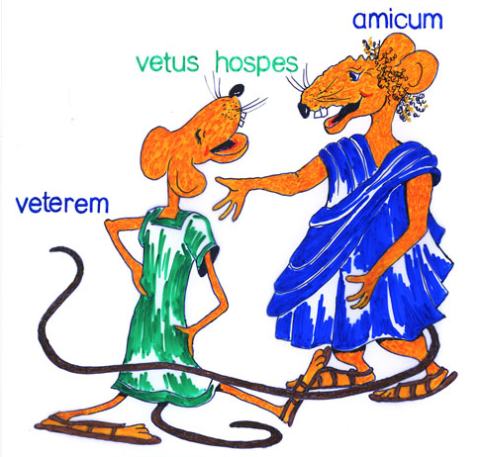
The town mouse is now doing the same to his old friend.

Slide 10
Once upon a time a country mouse is reported to have received a city-mouse into his poor cave, an old host, his old acquaintance; a blunt fellow and attentive to his acquisitions, yet so as he could [on occasion] enlarge his narrow soul in acts of hospitality. What need of many words? He neither grudged him the hoarded vetches, nor the long oats; and bringing in his mouth a dry plum, and nibbled scraps of bacon, presented them to him, being desirous by the variety of the supper to get the better of the daintiness of his guest, who hardly touched with his delicate tooth the several things: while the father of the family himself, extended on fresh straw, ate a spelt and darnel, leaving that which was better [for his guest]. At length the citizen addressing him, 'Friend,' says he, 'what delight have you to live laboriously on the ridge of a rugged thicket? Will you not prefer men and the city to the savage woods? Take my advice, and go along with me to the city: since mortal lives are allotted to all terrestrial animals, nor is there any escape from death, either for the great or the small. Wherefore, my good friend, while it is in your power, live happy in joyous circumstances: live mindful of how brief an existence you are.’
Translation: C. Smart (1863), courtesy of J. Kirby, Purdue University
olim rusticus urbanum murem mus paupere fertur
accepisse cavo, veterem vetus hospes amicum,
asper et attentus quaesitis, ut tamen artum
solveret hospitiis animum. quid multa? neque ille
sepositi ciceris nec longae invidit avenae,
aridum et ore ferens acinum semesaque lardi
frusta dedit, cupiens varia fastidia cena
vincere tangentis male singula dente superbo :
cum pater ipse domus palea porrectus in horna
esset ador loliumque, dapis meliora relinquens.
tandem urbanus ad hunc "quid te iuvat”
inquit,"amice,
praerupti nemoris patientem vivere dorso?
vis tu homines urbemque feris praeponere silvis?
carpe viam, mihi crede, comes ; terrestria quando
mortalis animas vivunt sortita, neque ulla est
aut magno aut parvo leti fuga : quo, bone, circa,
dum licet, in rebus iucundis vive beatus
:vive memor, quam sis aevi brevis."
Horace, Satire II 6 lines 79 - 96

Slide 11
Catullus poem 45
Catullus is describing the mutual love between Septimius and his girlfriend (suos amores) Acme.
Acmen Septimius suos amores
tenens in gremio ‘mea’ inquit ‘Acme …
The translation of the first few lines is:
Septimius, holding his girlfriend Acme in his embrace,
said ‘My dear Acme ….
Look at the word-order of line one. Who is ‘embracing’ whom?

Slide 12
Septimius, holding his lover Acme, in his bosom, said, “my Acme, if I do not love you with abandon and if I am not prepared to henceforth love you constantly for all our years, so many times as he who can die alone in Libya and in sweltering India, I shall come to meet the blue eyed lion.” As he said this, Love sneezed approval on the left as before on the right. But Acme, lightly bending back her head, and having kissed the infatuated eyes of the sweet boy with her wine-red mouth, said, “let it be thus, my life, my little Septimius: let us forever serve this one master, so that a passion far grander and keener may burn in my soft marrow.” As she said this, Love sneezed approval on the left as before on the right. Now, having started off on a good omen, they love and are loved like-mindedly. Poor little Septimius prefers Acme alone to Syria and Britain: the faithful Acme finds pleasure and desire in Septimius alone. Who has seen any one happier, who has seen a more blessèd love?
Acmen Septimius suos amores tenens in gremio ‘me’' inquit ‘Acme, ni te perdite amo atque amare porro omnes sum assidue paratus annos, quantum qui pote plurimum perire, solus in Libya Indiaque tosta caesio veniam obvius leoni.’ Hoc ut dixit, Amor sinistra ut ante dextra sternuit approbationem. At Acme leviter caput reflectens et dulcis pueri ebrios ocellos illo purpureo ore suaviata, ‘sic’ inquit ‘mea vita Septimille, huic uni domino usque serviamus, ut multo mihi maior acriorque ignis mollibus ardet in medullis.’ Hoc ut dixit, Amor sinistra ut ante dextra sternuit approbationem. Nunc ab auspicio bono profecti mutuis animis amant amantur. Unam Septimius misellus Acmen mavult quam Syrias Britanniasque: uno in Septimio fidelis Acme facit delicias libidinisque. quis ullos homines beatiores vidit, quis Venerem auspicatiorem?

Slide 13
The next illustration should be viewed with caution: the Romans would not need to rearrange the order of words in their minds in order to understand it.
Catullus 64 lines 112 – 115 describe the hero Theseus leaving the labyrinth of King Minos after killing the Minotaur. The princess Ariadne had given him a ball of thread to help him out of the maze.

Slide 14
inde pedem sospes multa cum laude reflexit
errabunda regens tenui vestigia filo,
ne labyrintheis e flexibus egredientem
tecti frustraretur inobservabilis error.
Then, safe, gaining much glory, he turned back his steps
directing his wandering footsteps with the slender thread
so that an unnoticed twist of the building would not confuse him
making his way out of the labyrinthine windings.

Slide 15
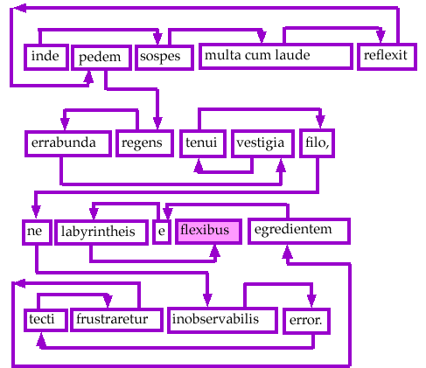
This artificial route through the maze of words is purely to aid English speakers – but it is one of the most convoluted passages in Latin poetry with the word-order all over the place. Even the Romans would have found it confusing, and that was obviously Catullus’ intention!

Slide 16
Pictorial approach to Latin poetry devised by Anne Dicks, creator of “Pyrrha’s Roman Pages” www.pyrrha.me.uk
original art work by Di Lorriman.

