Slide 1
People and Society at Aquae Sulis
Part Two : Collating the information gathered from individual inscriptions and other written evidence.
Find out where people came from, how citizens and their ex-slaves felt about each other and why they wanted to leave information about themselves on inscriptions.
Slides 4, 17 & 21 are designed to be printed and used as worksheets, and others can be adapted as worksheets if required.
The final slide suggests some conclusions which can be drawn from this evidence: answers to slide 4. Slide 18 has the answers for 17.

Slide 2
This is designed to be used AFTER a visit to the Baths, when students have also studied the individual inscriptions.
1. Religious inscriptions R1 – R10 watch the video on the web-page use the Decoding leaflet and web-page to interpret the inscriptions complete the Altars worksheet
2. Tombstone inscriptions T1 – T11 watch the video on the web-page use the Decoding leaflet and web-page to interpret the inscriptions complete the Tombstones worksheet
3. Public information, publicity and propaganda P1 – P11 (This section contains a range of artefacts of different types).
use the web-page to interpret the inscriptions
4. Curses C1 – C4 watch the Curses powerpoint to understand a few curse tablets
N.B. Translations and line-drawings of all the inscriptions are also available!

Slide 3
Citizenship, multiculturalism, slavery and the status of women:
who actually lived in Roman Bath?
how did the society work?
who were the slaves?
what was the status of freedmen and women?
how independent could a woman be?
what did it mean to be a Roman citizen?
was there any social mobility: could individuals improve their status in life easily?
How did the Romans extend their ‘Romanisation’ policy to create a feeling of unity throughout their empire?

Slide 4
Roman society 2 Name ………………………………..
Use information from the webpages, Decoders and your answers to the altars and tombstone sheets - or from the translation sheet .
What can we find out about ….
Slaves
2. Freedmen and Freedwomen Stones R6, R4, R5, T11, T7
Imperial freedmen Stone P5
4. Citizens of a town and decuriones (members of the Town Council)
Stones P3a, P3b
5. Women Stones T7, T8, T11
6. Roman citizens Stones R1, R4-5, P4, P9, T2, T11, R8, T8
Roman soldiers Stones T2, T3, T4, R4, R5, R8, P4
Emperors Stones R8, P1, P2, P5, P6
List the places around the world where the people came from.
Stones T2, T3, T4, T7, T8, R3, R7
10. Tradesmen/advertisers Stones R7, R10 (P7, P8)

Slide 5
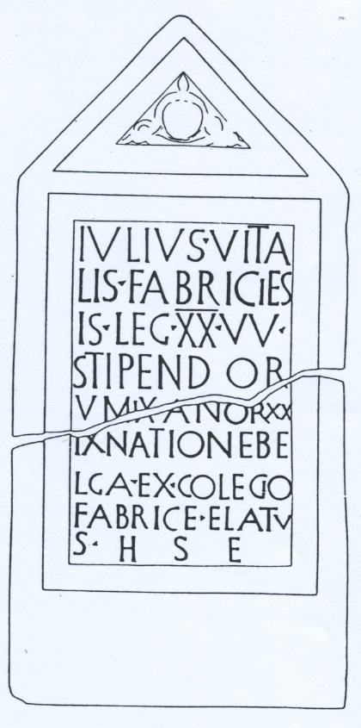
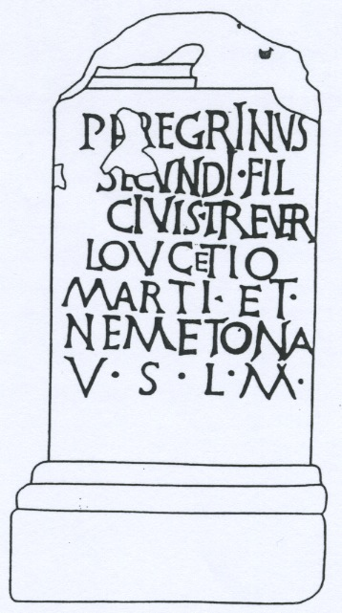
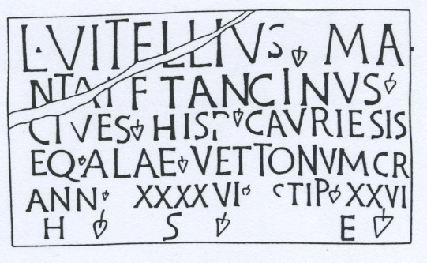
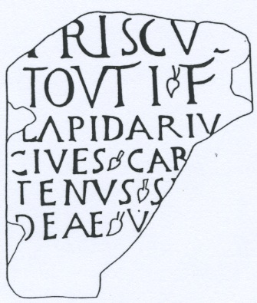
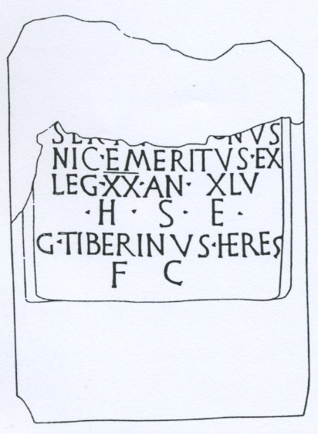
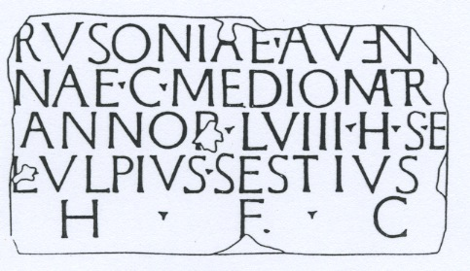
Several people who left dedicatory altars or tombstones at Bath recorded where they originally came from …..
T3 Julius Vitalis
R3 Peregrinus
EX NATIONE BELGA
from the Belgae tribe
CIVIS TREVER
citizen of Trier
T2 Vitellius Tancinus
CIVES HISP CAURIENSIS
citizen of Caurium in Spain
R7 Priscus
CIVES CARNUTENUS
citizen of Chartres
T4 Antigonus
NIC
of Nicopolis
T8 Rusonia
C MEDIOMATR
citizen of Metz

Slide 6
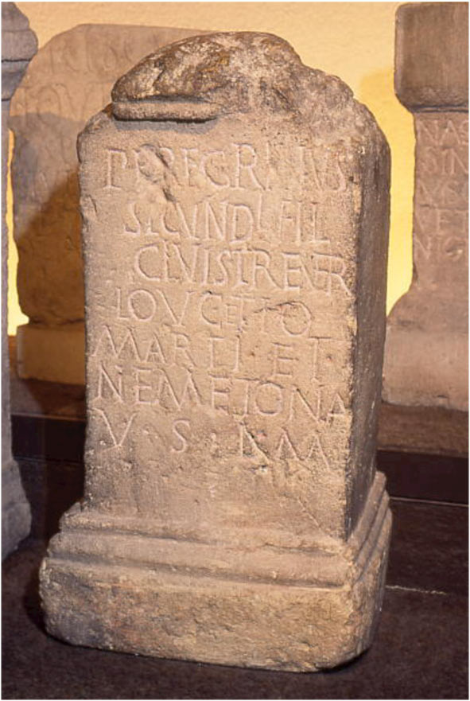
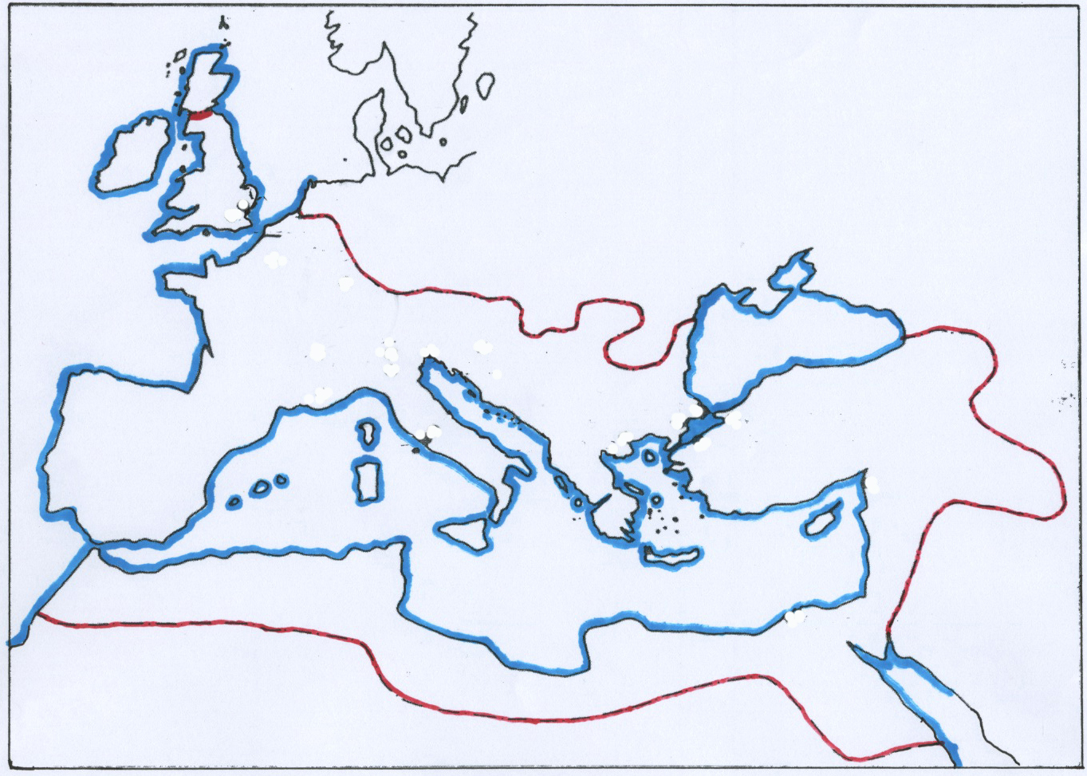
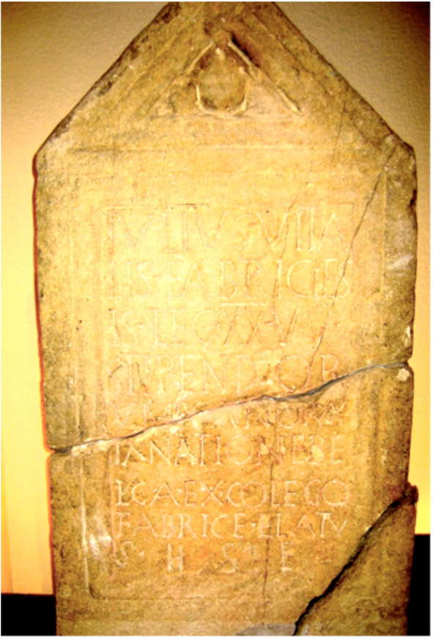
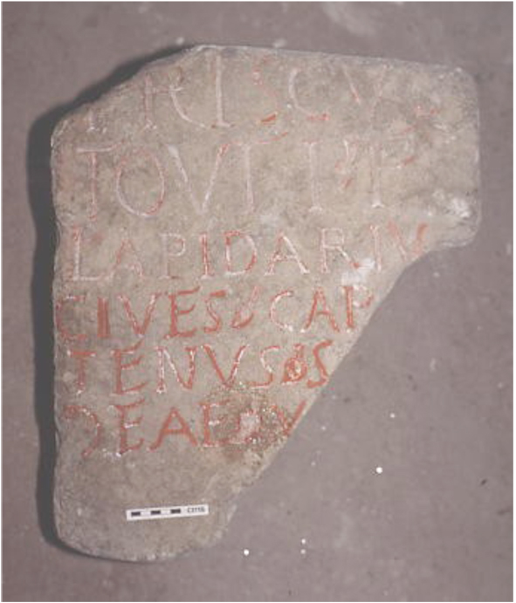
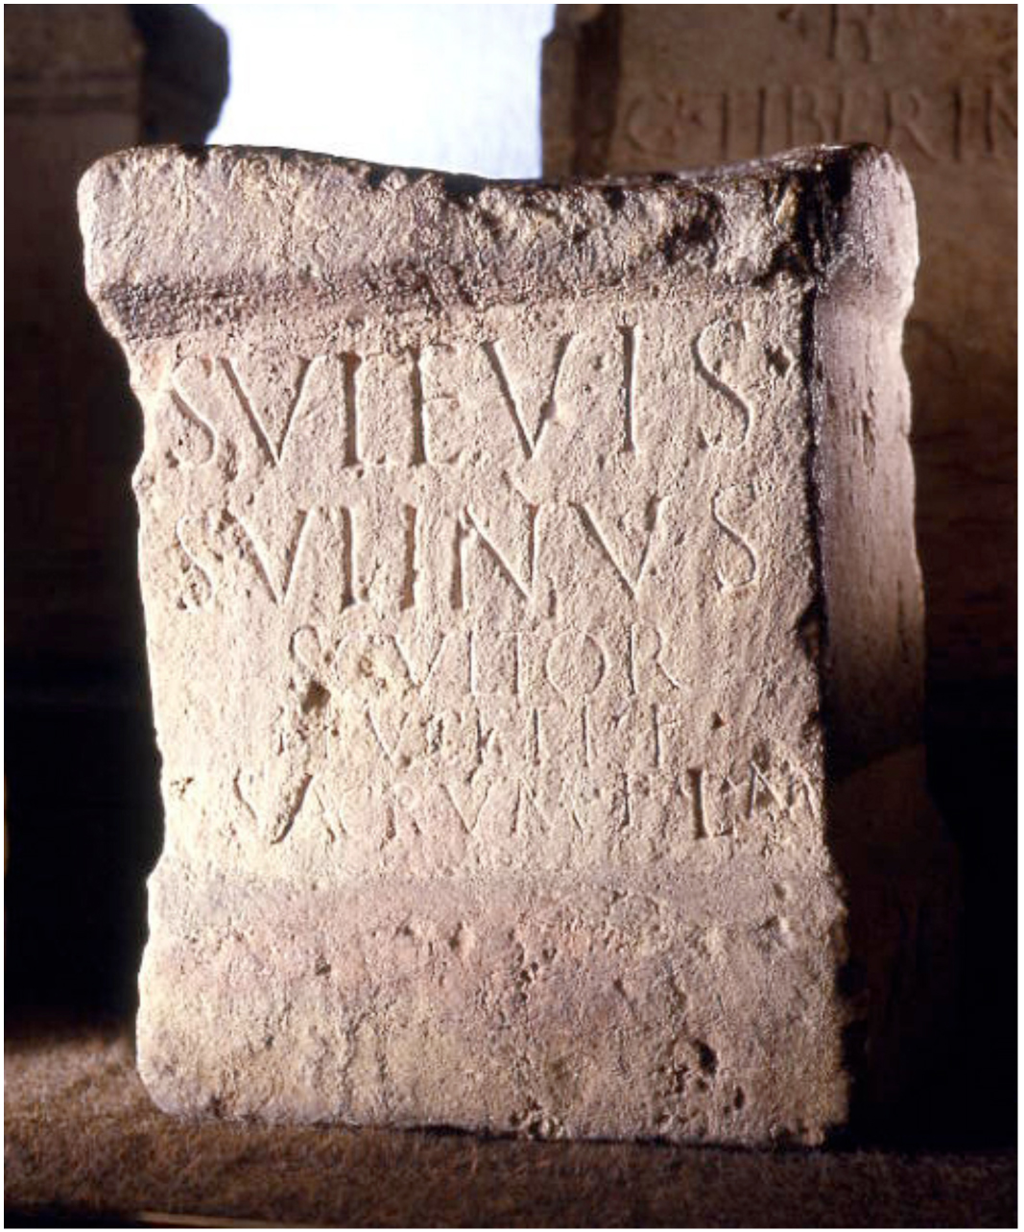
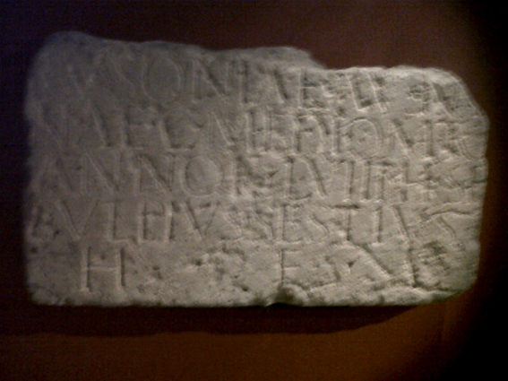
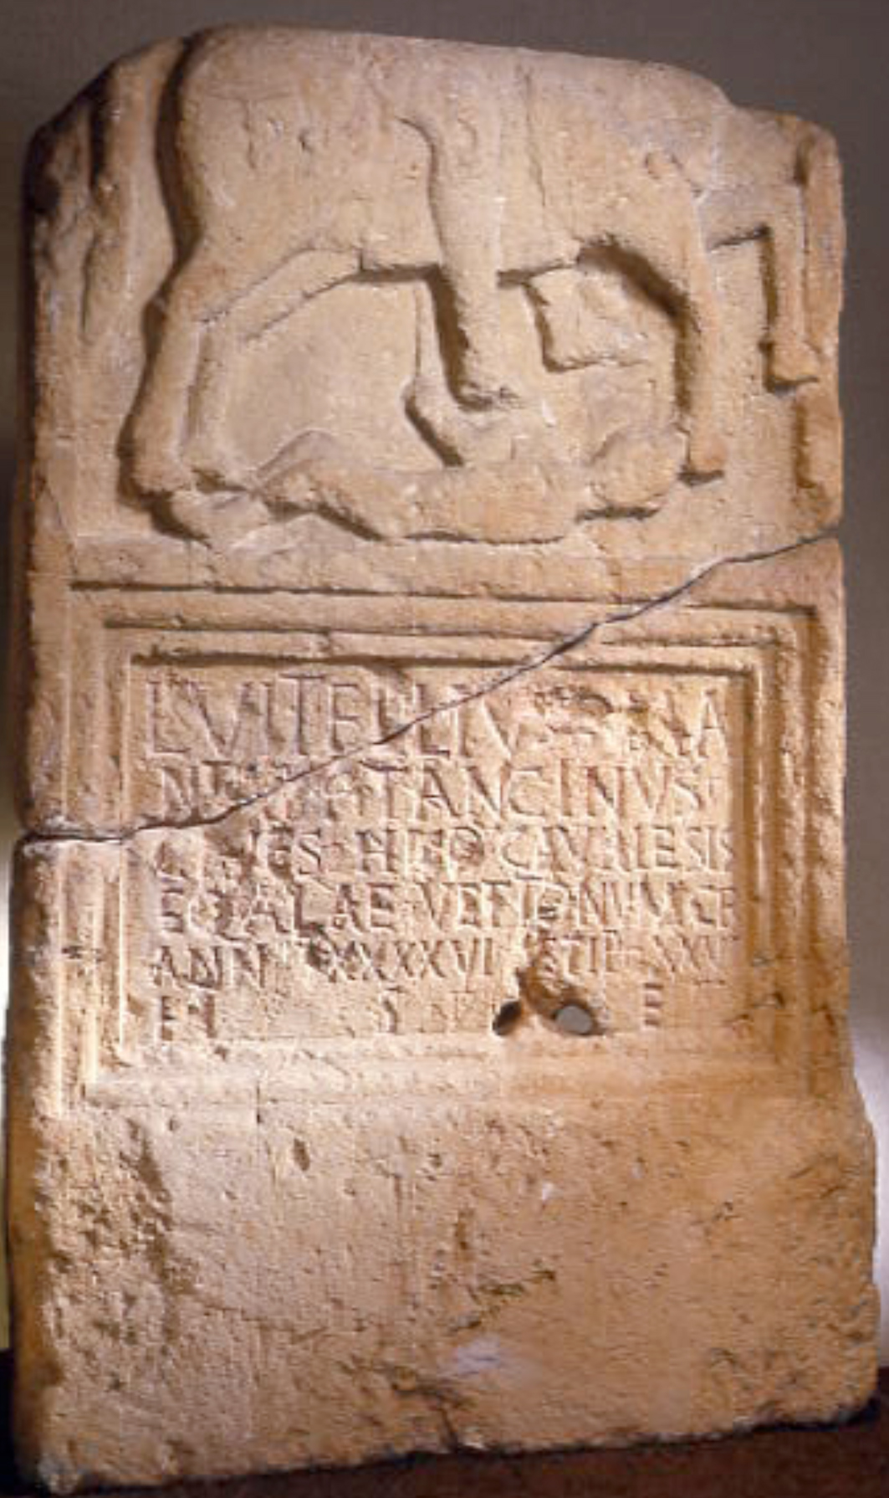
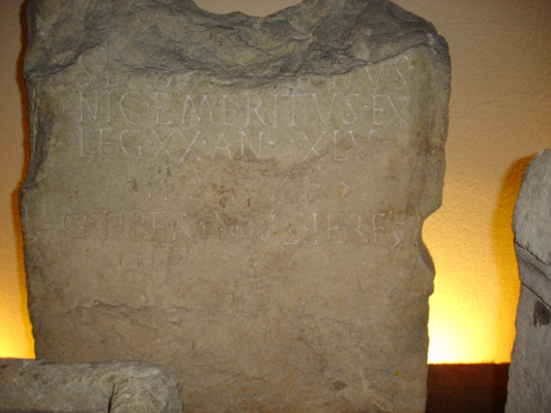
Many different nationalities were represented at Bath – and these were wealthy enough to commission inscribed stones.
France T3, R7, T8
Julius Vitalis from the Belgae
Priscus from Chartres,
Rusonia from Metz
Germany R3
Peregrinus from Trier
Suleviae
goddesses
Syria
man
in coffin
Spain T2
Tancinus
Greece T4
Antigonus
… and Sulinus (R10) dedicated a stone to goddesses who originated in the Danube basin: anywhere from Germany to the Black Sea …..

Slide 7
From this multicultural mix, who were socially superior?
T2 Vitellius Tancinus from Spain.
C R = CIVES ROMANI
This tells us that all of the ‘Alae Vettonum’ – the cavalry regiment of the Vettones tribe – had been granted Roman citizenship.
Vitellius Tancinus outranked the wealthiest citizens in Aquae Sulis because he was a Roman citizen.

Slide 8
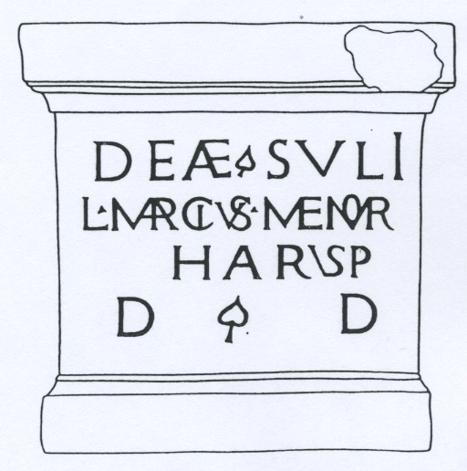
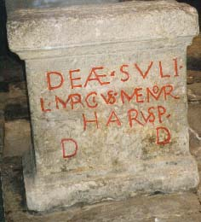
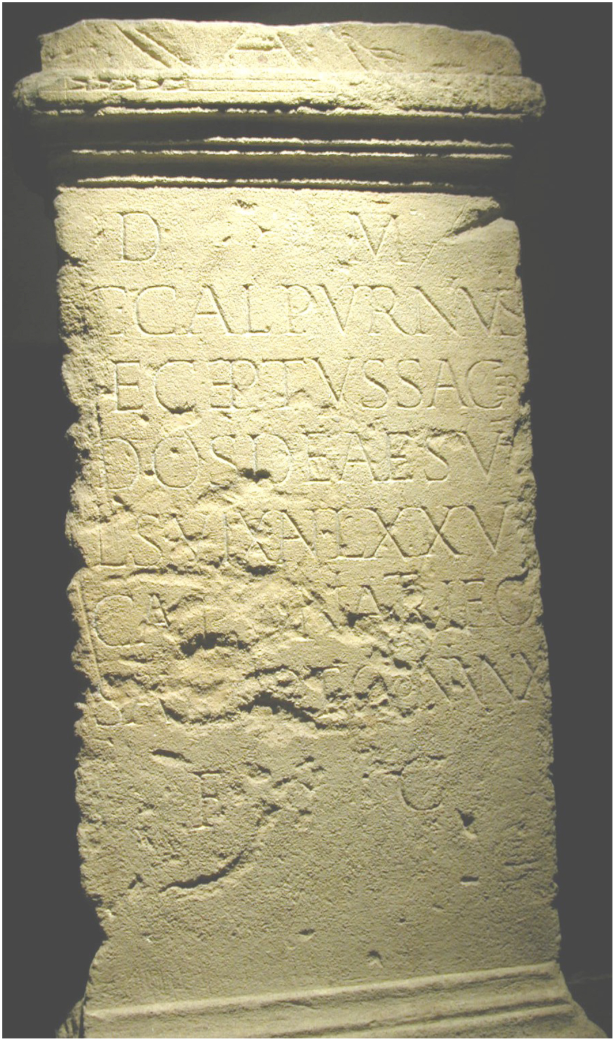
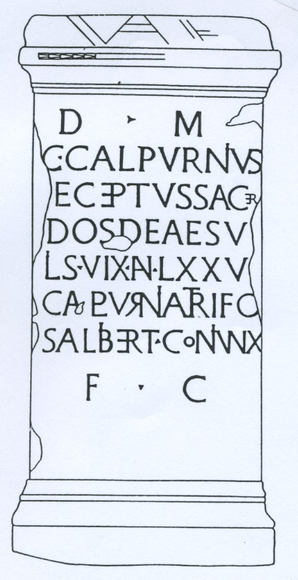
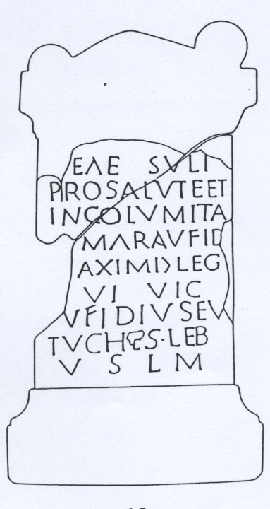
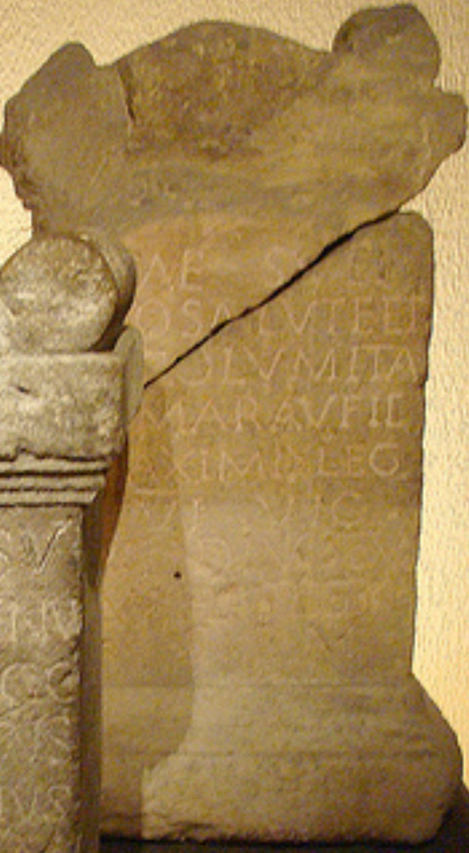
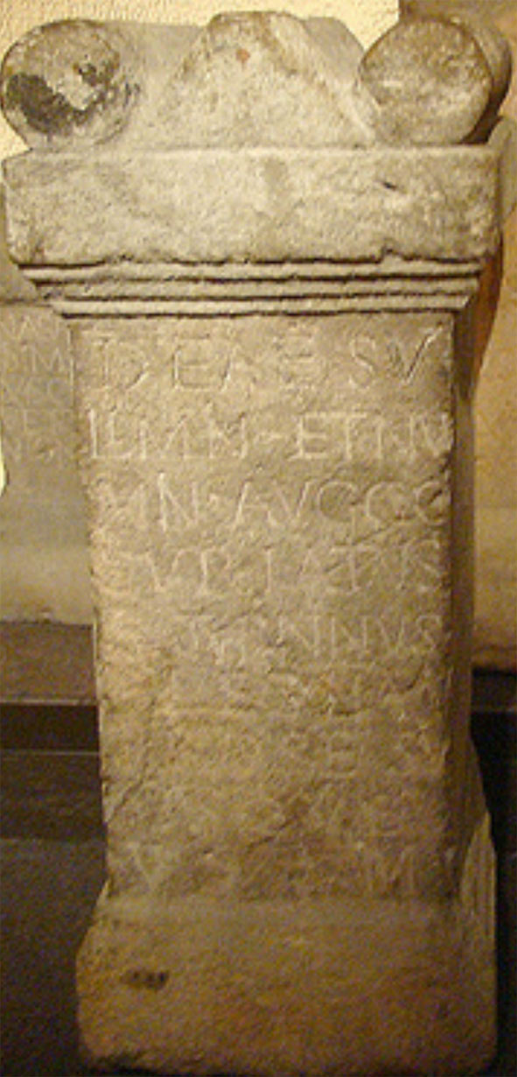
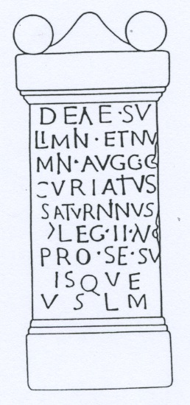
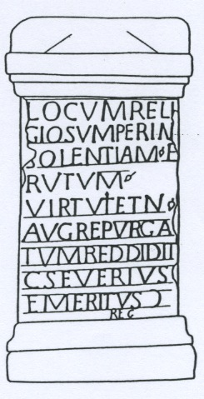
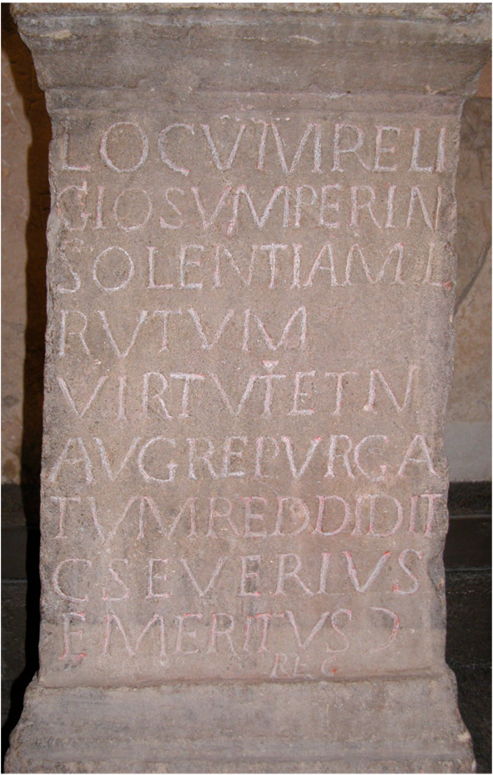
Look at these stones to find Roman citizens - people with 3 names:
T11
R1
Gaius Calpurnius
Receptus
Lucius Marcius Memor
R5
R8
Marcus Aufidius
Maximus
Gaius
Curiatius
Saturninus
P4
T8
Gaius Severius
Emeritus
Lucius Ulpius Sestius
Rusonia Aventina’s heir

Slide 9
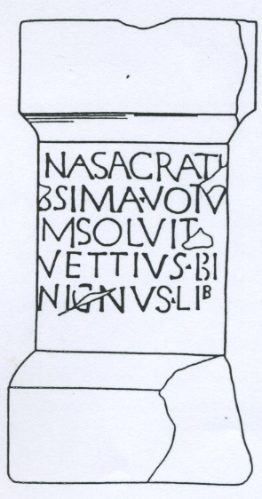
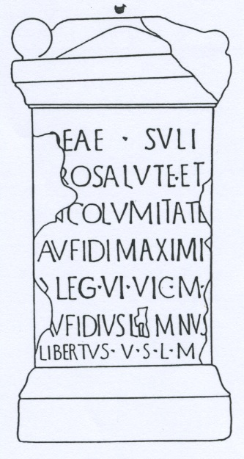
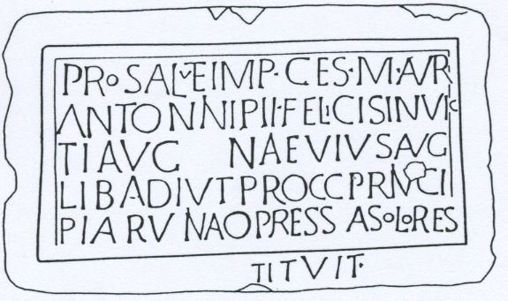
Look at these stones to find some freedmen/women (ex-slaves).
Should we be surprised that they had enough money to pay for inscribed stones?
R6
Was Vettius Benignus a keen huntsman thanking Diana for a successful day out?
……………………………………………………………..
T11
Vettius
Benignus
Calpurnia
Trifosa
Was there some sort of rivalry between Lemnus and Eutuches, both erecting stones to thank Sulis for protecting their ex-master?
(but notice the mistake on Lemnus’s name!)
Their master’s legion was not transferred to Britain until about 122 A.D. so the stones cannot be earlier than this date, which was also the date when the Emperor Hadrian visited Britain.
…………………………………………………………………
R4
The slave-girl Trifosa enjoyed a leap in status when Calpurnius decided to free her and marry her!
Aufidius
Lemnus
R5
Imperial freedmen like Naevius ran the civil service and many seemed to have as much power and status (or even more!) than free citizens did.
P5
Aufidius
Eutuches
Naevius

Slide 10
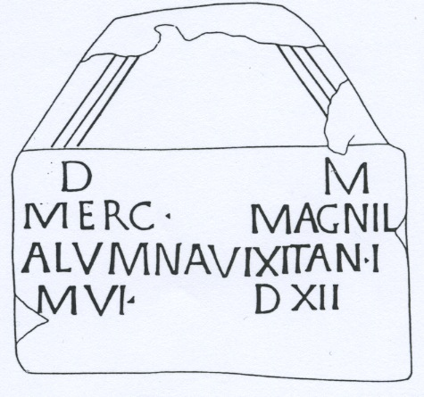
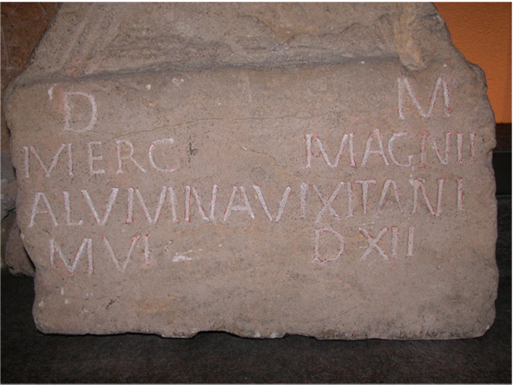
another freedwoman ….
T7
Little Mercatilla’s tombstone is perhaps the most surprising.
AN I M VI DXII – the length of her life is shown in years, months and days.
MAGNI L(iberta) shows that she was originally Magnus’s slave, and ALUMNA shows that he had adopted her.
This is a high-status funeral monument for a little girl who was obviously loved very much.

Slide 11
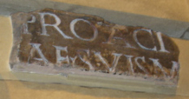
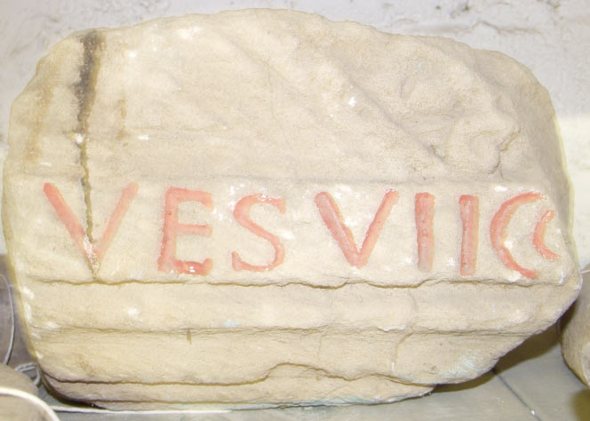
Look at stones P3a, P3b, P4 and P1 to find out who advertised their responsibility for building or repair work at Aquae Sulis.
P3a P3b
Claudius Ligur and Gaius Protacius
feature prominently in the inscription above the façade of the Four Seasons – they were presumably decuriones – members of the Town Council.
P4
P1
Gaius Severius Emeritus, the centurion in charge of the area, tells us on this stone that he repaired the holy area after it had been desecrated by vandalism: per insolentiam
Who might have vandalised it?
Christians?
This inscription tells us that some building work was completed during the Emperor Vespasian’s 7th year of consulship: 75 A.D.
There is a further religious aspect to this stone, as it is dedicated To the Virtue and Deity of the Emperor. (AVG)

Slide 12
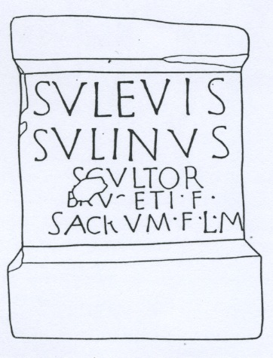
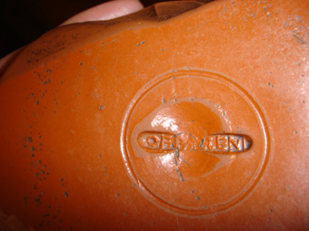
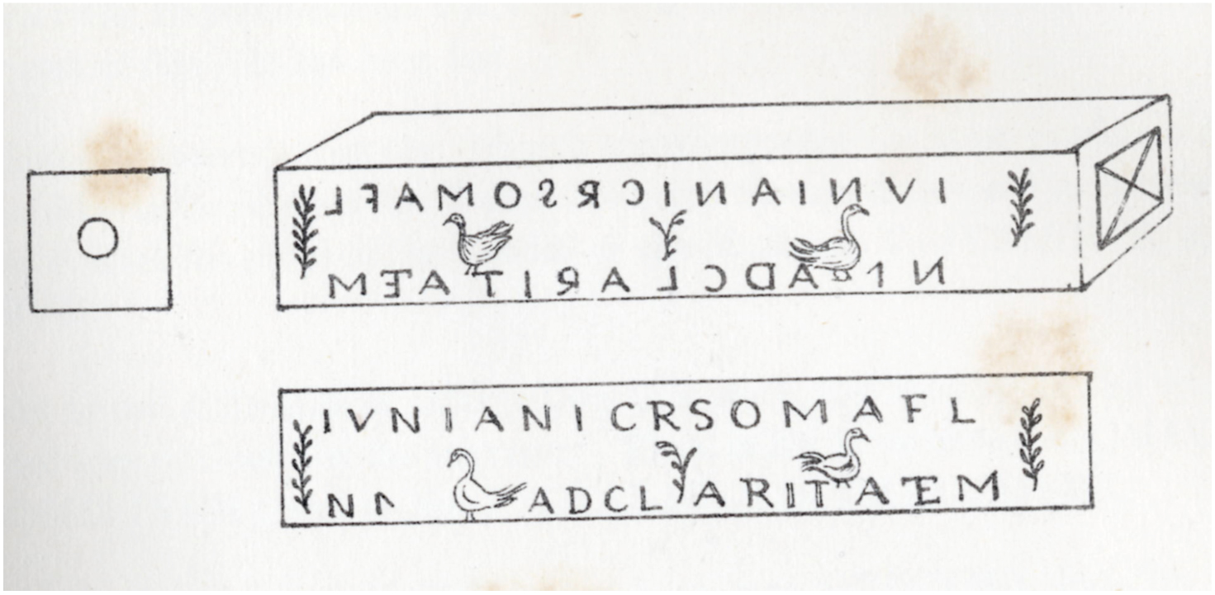
Look at these artefacts to find some tradesmen.
R7
If you were a stonemason
LAPIDARIUS
SCUL(P)TOR
perhaps dedicating an altar to the goddess could also serve as a useful advertisement for your business!
R10
P4
just like this potter’s stamp on the base of a Samian pot
and this stamp for an eye-doctor’s block of ointment.
P4

Slide 13
This lead ingot (‘pig’) bears the inscription
IMP HADRIANI AVG
All precious metals in the empire belonged to the Emperor and a vast amount was needed for pipework and linings at the Baths complex.
P2
Look at the selection of pipe-work in the museum (near the entrance to the Great Bath) and find the identification marks on each section.
All the lead was tracked carefully and stamped at each stage of manufacture to ensure that none went missing!

Slide 14
Just outside Bath, an Imperial freedman called NAEVIUS records his repair work at the headquarters of an Imperial estate which might have been organising the distribution of Bath stone.
An ex-slave of the Emperor AUG[usti] LIB[ertus] would run all enterprises like this because the Emperor felt he could trust his loyalty.
P5
All these names refer to the Emperor better known to us by his nickname of CARACALLA.
This shows how important it was for the emperor to keep personal control of all valuable natural resources in the provinces.

Slide 15
When you visit the museum,
look out for evidence of the workmen who did the building work (near the entrance to the Great Bath).
Marks on the stones suggest that a tally was kept as a record of how many stones each man completed!

Slide 16
And of course some stones refer to soldiers …
T2
R4
Lucius Vitellius Tancinus
Julius Vitalis
… Antigonus
Marcus Aufidius Maximus
(2 votive altars)
Gaius Curiatius Saturninus
Gaius Severius Emeritus
R8
T3
R5
P4
T4
It can be interesting to compare the information about their careers in the army …

Slide 17
stone no. | type of stone | rank | unit / job | years’ service | age at death
T2
T3
T4
R4-5
R8
P4

Slide 18
stone no. | type of stone | rank | unit / job | years’ service | age at death
T2 | TOMBSTONE | HORSEMAN | Vettones’ cavalry regiment | 26 | 46
T3 | TOMBSTONE | ARMOURER | 20th Legion Valeria Victrix | 9 | 29
T4 | TOMBSTONE | VETERAN (retired) | 20th Legion | he would have completed 20 or 25 years | 45
R4-5 | VOTIVE ALTAR | CENTURION | 6th Legion Victrix | --- | ---
R8 | VOTIVE ALTAR | CENTURION | 2nd Legion Augusta | --- | ---
P4 | BUILDING INSCRIPTION (& ALTAR) | CENTURION | civil administration | --- | ---

Slide 19
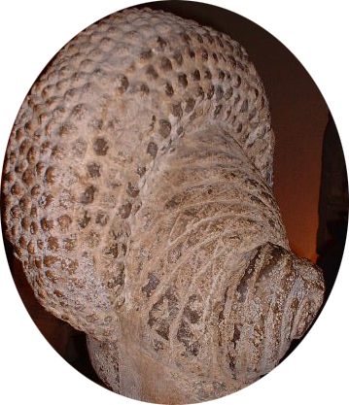
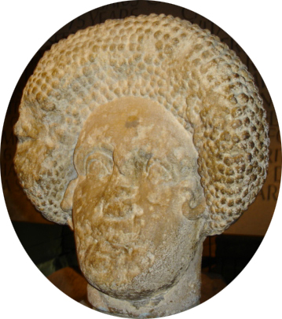
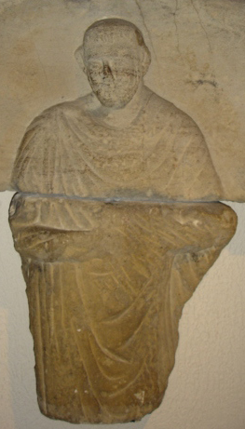
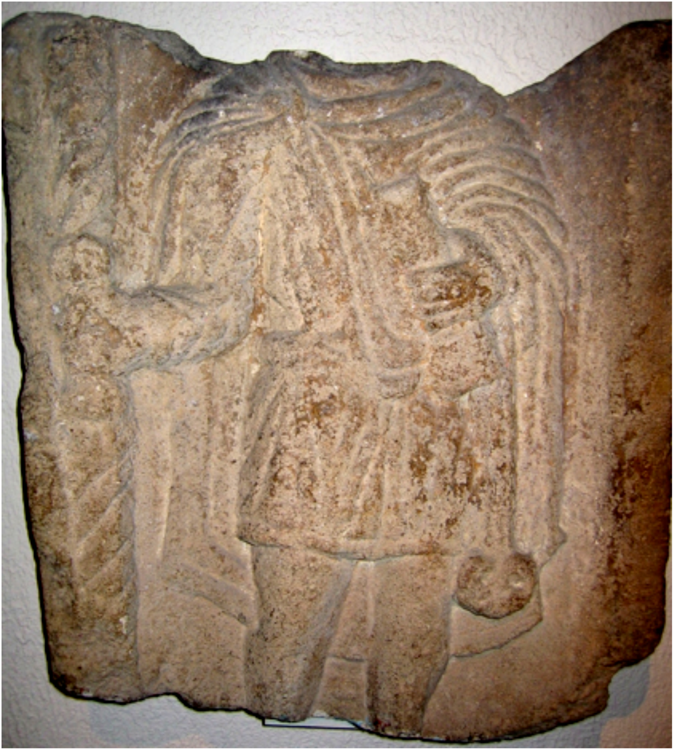
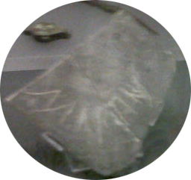
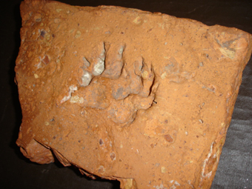
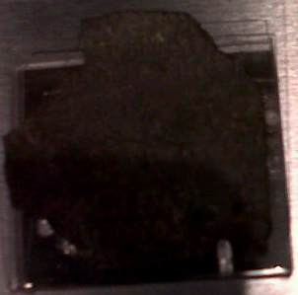
..but here are some questions we can’t answer:
Was the lady with this amazing hairstyle kind to the slaves who were her hairdressers?
Was the man in the toga born in Britain?
What was the officer (a Standard-Bearer – Imaginifer - shown bottom left) doing in Bath? Which Emperor was depicted on the standard he was carrying?
Why did Martinus scratch his name on a dish?
Why does only a small portion remain of the precious Diploma of citizenship awarded to a soldier when he retired?
and what was the name of the dog who left his pawprint for us?

Slide 20
The people who have left inscriptional evidence have allowed us to get much closer to them
and we should not be put off by the fact that they spoke a slightly different language!

Slide 21
Find the names of people from all these different countries who were wealthy enough to commission inscribed stones at Aquae Sulis.
France T3, R7, T8
…………….. from the Belgae
……………... from Chartres,
…………….. from Metz
Germany R3
………………. from Trier
Name of Goddesses
………………
R10
Syria
man in coffin (no name)
Spain T2
…………….
Greece T4
……………….
R10 (above right) was dedicated by ………………………. to goddesses who originated in the Danube basin: anywhere from Germany to the Black Sea …..

Slide 22
Information which can be obtained from analysing the inscriptions
Slaves None left inscribed stones, not surprisingly. However, all the freedmen and freedwomen discussed in q.2 started life as slaves. They were valued enough by their masters to be granted their freedom. Little Mercatilla (T7) was only one year old when she died: presumably she had been born as the child of one of her master’s slaves and her master decided to adopt her. We do not know if he freed and married her mother, which is what happened to Calpurnia Trifosa (T11). If a master wanted to marry one of his slaves he had to free her first.
Freedmen and Freedwomen Stones R6, R4, R5, T11, T7 See q.1 for T7 and T11. R4 and R5 were erected by two freedmen belonging to the same centurion. This shows that centurions had their household with them and could be rich enough to own several slaves and/or freedmen. When a slave was freed his former master would make sure that he had enough money to support himself and the slave would become a ‘client’ who was dependent in various ways. Some freedmen could become very rich. It is interesting to speculate why the two freedmen felt the need to thank the goddess Sulis for protecting their former master. Some historians suggest that the two slaves were freed to celebrate the visit of the Emperor Hadrian to Britain in 122 A.D. The stonemason appears to have made a mistake in giving three names to Aufidius Lemnus : the first name Marcus must belong to his former master, not to the freedman because having three names was the status symbol of being a Roman citizen! R6 is an altar dedicated to Diana, the goddess of hunting. Did the freedman Vettius Benignus enjoy hunting as a sport, or did he have a business to do with hunting?
Imperial freedmen Stone P5 shows that Naevius, a freedman of the Emperor, was important enough to have his name on a building inscription and to have played a big part in organising the rebuilding of a headquarters building. This stone was found outside Bath at what is thought to have been an Imperial estate organising the distribution of Bath stone from quarries and it is at present in storage at the museum. The first part of the inscription shows that the building was dedicated for the welfare of the Emperor Caracalla, so there was a religious function for the inscription. Imperial freedmen ran the civil service and would feel a particular loyalty to the Emperor.
Citizens of a town and decuriones (members of the Town Council) Stones P3a, P3b Local officials were expected to pay for building works and would use the opportunity to display their names prominently, presumably in the hope that people would vote for them again in the future. These men would presumably be native Britons who had prospered in the town, showing that there was competition for places on the town council. The curse tablets in the museum - several are discussed in the ‘Curses’ powerpoint – seem to have been dedicated by less affluent people. The type of misdemeanour which the writers of the curses want to be recognised and avenged by the goddess are relatively small: e.g. the theft of a cloak or gloves. This suggests that poorer citizens of Aquae Sulis were attracted to this type of religious activity.
Women Stones T7, T8, T11 See q.1 for T7 and T11. Calpurnia Trifosa (T11) presumably became a wealthy woman on the death of her husband, the priest Gaius Calpurnius Receptus. She was obviously proud of her status, since she mentions it on her husband’s tombstone. Rusonia Aventina (T8) is an interesting example of a wealthy independent woman. She came from Metz in France and lived to a good age, showing that she probably had an affluent lifestyle. She had charge of her own money and property, shown by the fact that she has a named heir who was a Roman citizen – we know this fact because he had three names.
Roman citizens Stones R1, R4-5, P4, P9, T2, T11, R8, T8 Lucius Marcius Memor (R1) would have been a Roman citizen of high status. There were very few ‘haruspexes’ in the Roman world and it shows what an important religious site Aquae Sulis was. His importance is further shown by the positioning of his dedication stone right in the middle of the sacred area, next to the big sacrificial altar outside the temple in the courtyard. Gaius Calpurnius Receptus (T11) was a priest of Sulis and lived to the age of 75. Marcus Aufidius Maximus (R4-5), the centurion, had two stones dedicated in his honour by his freedmen (see q.2) Another centurion, Gaius Curiatius Saturninus, (R8) dedicated a stone to safeguard the health of his family and another centurion, Gaius Severius Emeritus (P4) had a job with the civilian administration, dedicating a building inscription to the Virtue and Deity of the Emperor, after rebuilding a sacred area which had been vandalised – possibly by Christians! See q.5 for Rusonia’s heir Lucius Ulpius Sestius. P9 is part of an auxiliary soldier’s discharge certificate, showing that he had been granted Roman citizenship on his retirement and T2 shows that Tancinus from Spain belonged to a squadron of cavalrymen from that area who had all been granted Roman citizenship for some reason.
Roman soldiers Stones T2, T3, T4, R4, R5, R8, P4 – see the chart for military information we can gather about soldiers at Aquae Sulis.
Emperors Stones R8, P1, P2, P5, P6 Vespasian and Hadrian were both involved in the building of the Baths. Other stones show that Emperors – or at least the personification of their ‘Virtue’ or ‘Welfare’ were worshipped in the same way as other gods and goddesses: shown by the formulaic VSLM. Stone R8 shows that sometimes Emperors shared their power: the first co-emperorship was between Marcus Aurelius and Verus in 161 – 9 A.D. P2, P5 & P6 show what a close watch was kept on the supply of precious metals and quarried stone and give evidence for a highly organised bureaucracy run by imperial freedmen. The emperors kept control by having their own ex-slaves in charge of vast profit-making enterprises and all precious metals and natural resources belonged to the Emperor.
List the places around the world where the people came from. Stones T2, T3, T4, T7, T8, R3, R7 see the map for people’s places of birth.
10. Tradesmen/advertisers Stones R7, R10 (P7, P8) The museum no longer has the eye-doctor’s ointment stamp, but the line-drawing was made last century and it is interesting to see how he marketed his wares. Passienus’s Samian shard is part of the handling collection which schools can use. Were the two stonemasons (R7 & 10) particularly religious or was it a useful marketing strategy to place an altar here where other potential customers could see it and perhaps commission one for themselves?

