Slide 1
Aquae Sulis
and Romanisation
This presentation uses evidence from Roman Bath to illustrate how aspects of native British culture were integrated into the Roman way of life to create a distinctive ‘Romano-British’ culture and religion.
Slide 4 can be printed as a worksheet. (outline answers on slide 24)
The final slide is an information sheet. (duplicated from 1st powerpoint)
Teachers can add their own material and adapt the presentation to suit their own requirements.
Further information about how to translate the inscribed stones can be found in the ‘Decoding Roman Religious Inscriptions’ leaflet and on the web-page ‘Religious Inscriptions’.

Slide 2
PART TWO:
More gods and goddesses, and their part in the
Romanisation of Britain.

Slide 3
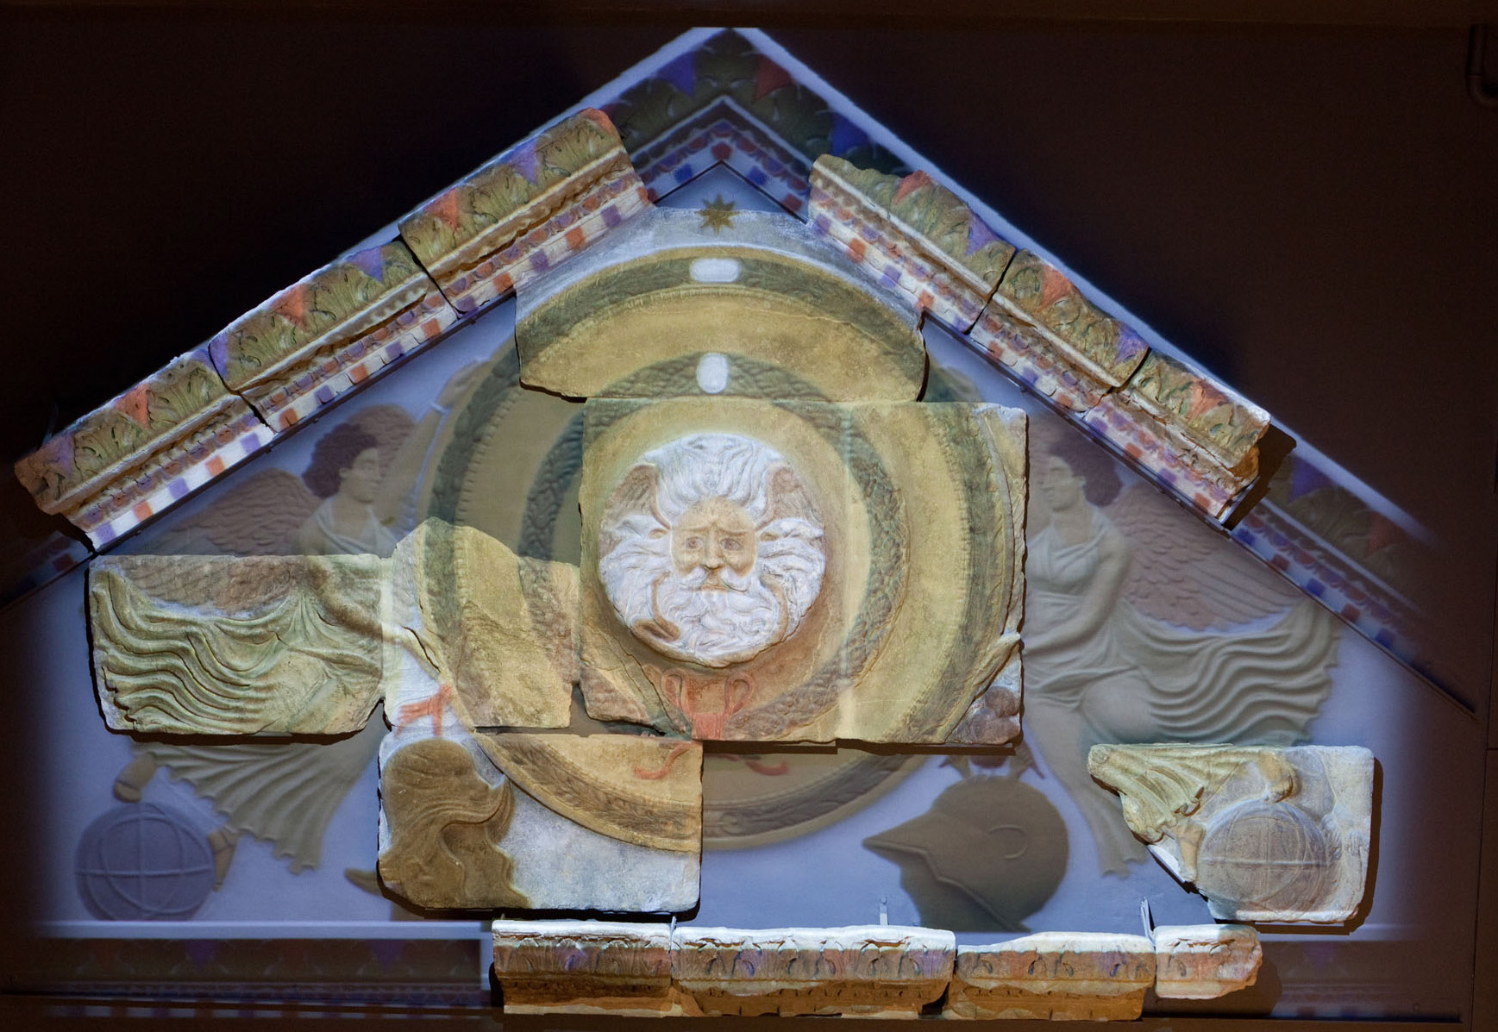
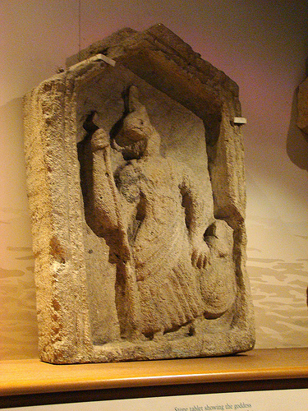
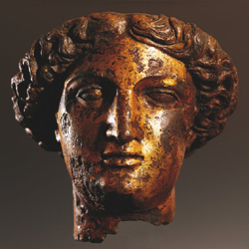
As well as Sulis Minerva, there is a wealth of evidence for other gods and goddesses being worshipped in and around the sacred precinct.

Slide 4
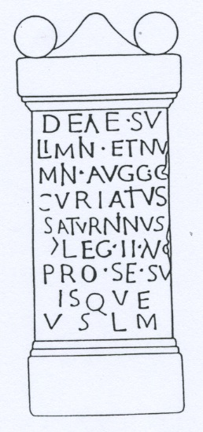
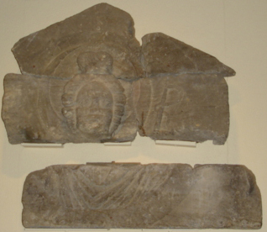
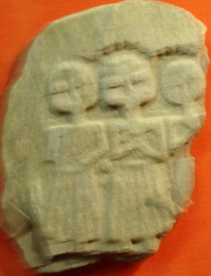
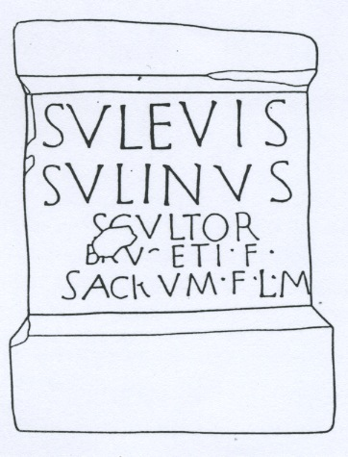
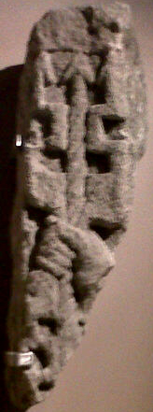
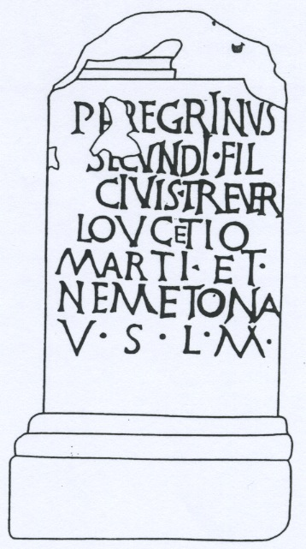
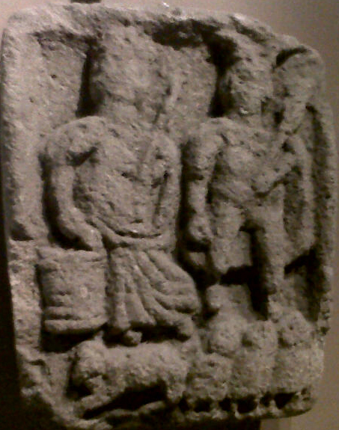
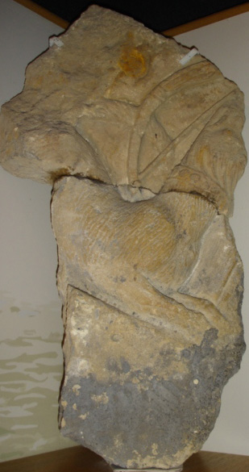
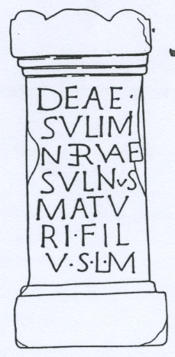
Gods and Goddesses worshipped at Bath: write your own notes as you watch the powerpoint. Name ……………………..
head of goddess framed by moon
hand holding
thunderbolt
goddess with bucket and god with wings and caduceus, above an animal and three cloaked figures
hound looking
up at goddess

Slide 5
This carved altar from Bath shows another example of the ‘fusion’ of Roman and Celtic religion.
The figures are the Celtic goddess Rosmerta (identified by the bucket-like container she is holding) and the Roman god Mercury (identified by his wings and wand).
His wings look a bit like horns, an attribute of many Celtic gods.
Notice the 3 Genii Cucullati under Mercury’s feet and the animal under Rosmerta’s feet – representing either a sacrifice or a sacred animal.

Slide 6
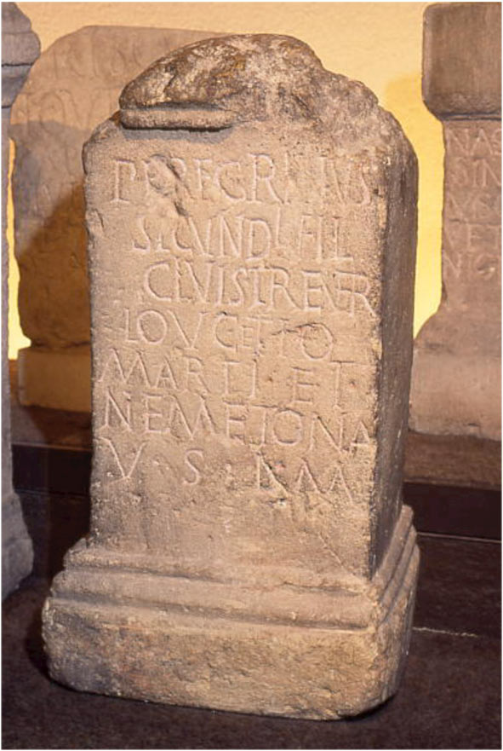
Look at lines 4 – 6 for the gods’ names:
Peregrinus has dedicated this stone
‘to Loucetius Mars and Nemetona’
Loucetius is the Celtic equivalent of the Roman war-god Mars, and Nemetona is a Celtic goddess.
Again the spelling has changed:
Loucetio Marti = to Loucetius Mars
VSLM : ‘happily and deservedly kept his promise (to erect this stone as an offering)’.
Before Peregrinus left home he would have promised to make an offering to the gods if they did something for him – perhaps enabling him to get to Aquae Sulis safely.
He came from Trier, where there was a temple to ‘Lenus Mars’ and his Celtic consort Ancamma. He obviously felt that Loucetius Mars and Nemetona were similar divinities.

Slide 7
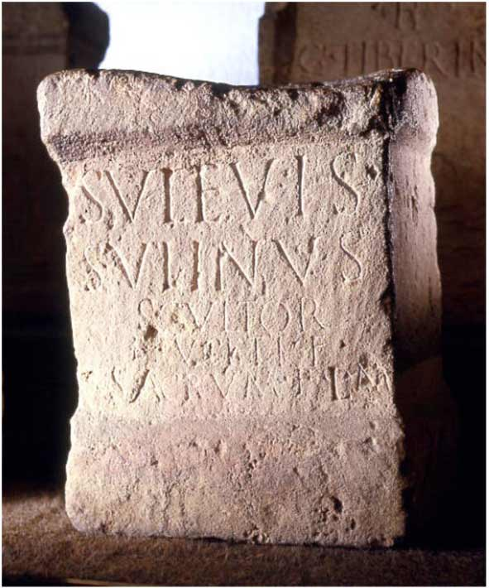
This dedication is to the ‘Suleviae’
– the three Celtic Mother Goddesses.
The stone probably accompanied a statue or carving.
This shows that the offerings in Bath were given to gods from all over the Roman world.
The ‘Deae Matres’ were worshipped throughout Britain, Gaul, Germany and North Italy and they were known as the Suleviae in the Danube area.
To the Suleviae, Sulinus, a sculptor, son of Brucetus, made this sacred object happily and deservedly.
SACRUM F(ecit) : ‘made this sacred object’

Slide 8
This fragment shows a hand holding a thunderbolt
- which god does that suggest?

Slide 9
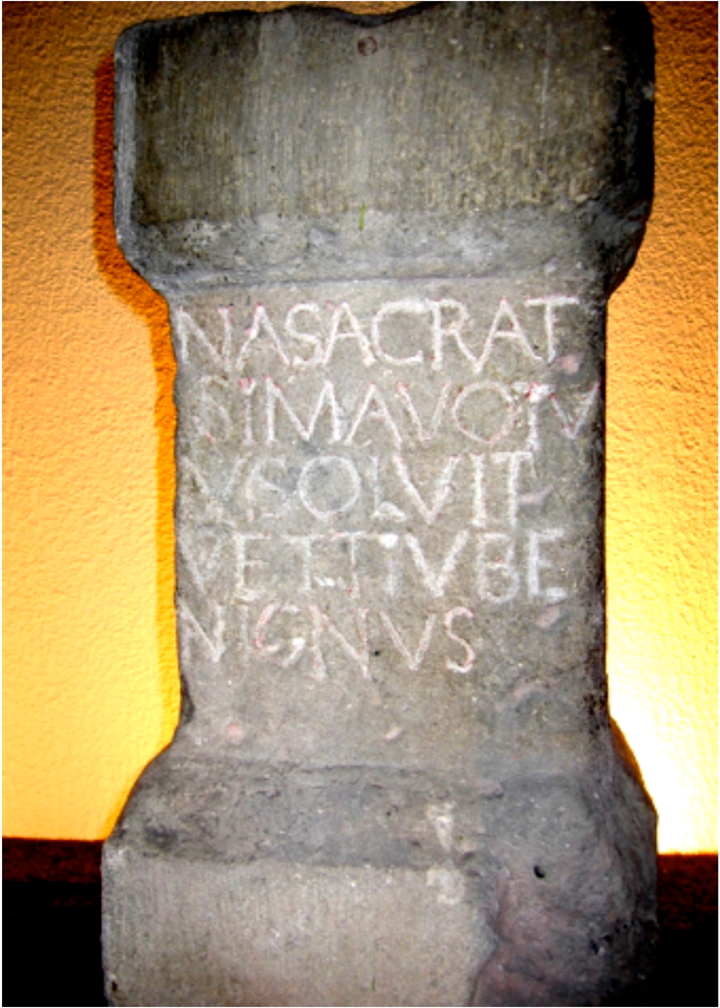
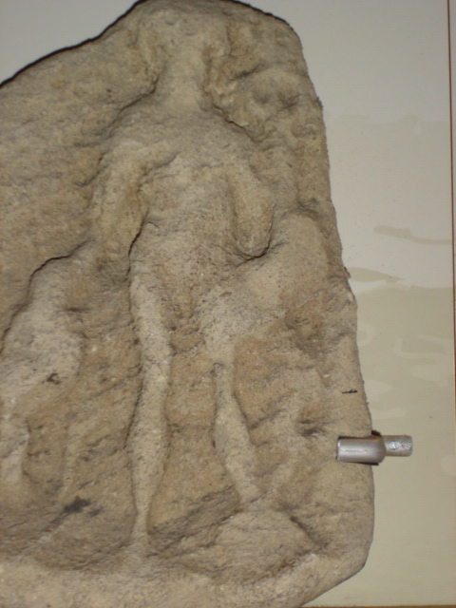
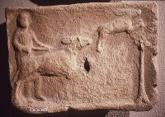
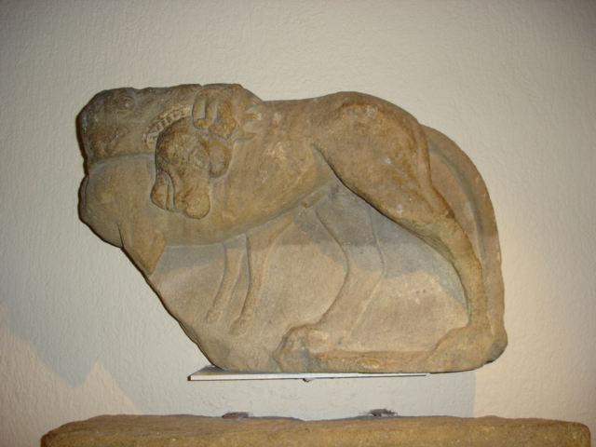
This altar to Diana (NA) was dedicated by Vettius Benignus.
You can see ‘VOTUM SOLVIT’ in the 2nd and 3rd lines with his name at the end.
The carvings show hunting scenes, which may be from votive altars or tombstones.

Slide 10
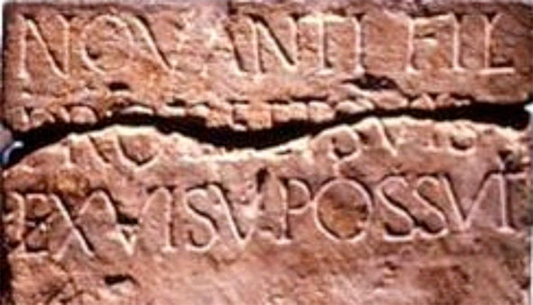
This inscription gives neither the name of the god or goddess nor the name of the person who dedicated it: we just know that he was the son of Novantius and he placed this here (possuit – spelling mistake for posuit!) following a dream (ex visu).

Slide 11
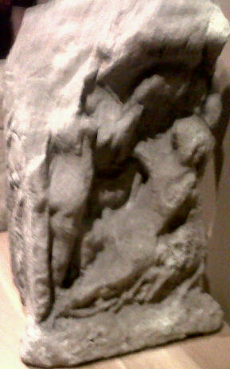
This inscription gives neither the name of the god or goddess nor the name of the person who dedicated it: we just know that he was the son of Novantius and he placed this here (possuit – spelling mistake for posuit!) following a dream (ex visu).
A nearby carving depicts the birth of Aesculapius, the Roman god of healing. It was a feature of his worship to spend the night in or near his temple and hope for a sacred dream which would lead to a cure. Perhaps this was also a feature of the worship of Sulis Minerva, or perhaps there was a separate shrine to Aesculapius? Perhaps people spent the night in the building with the Luna pediment?

Slide 12
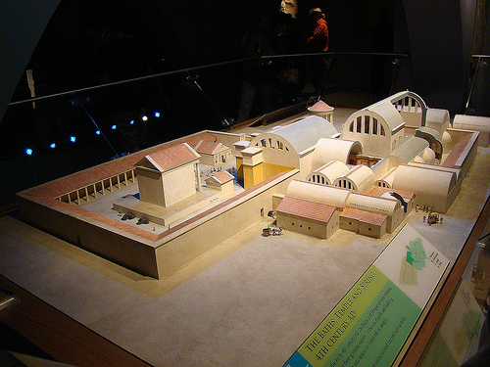
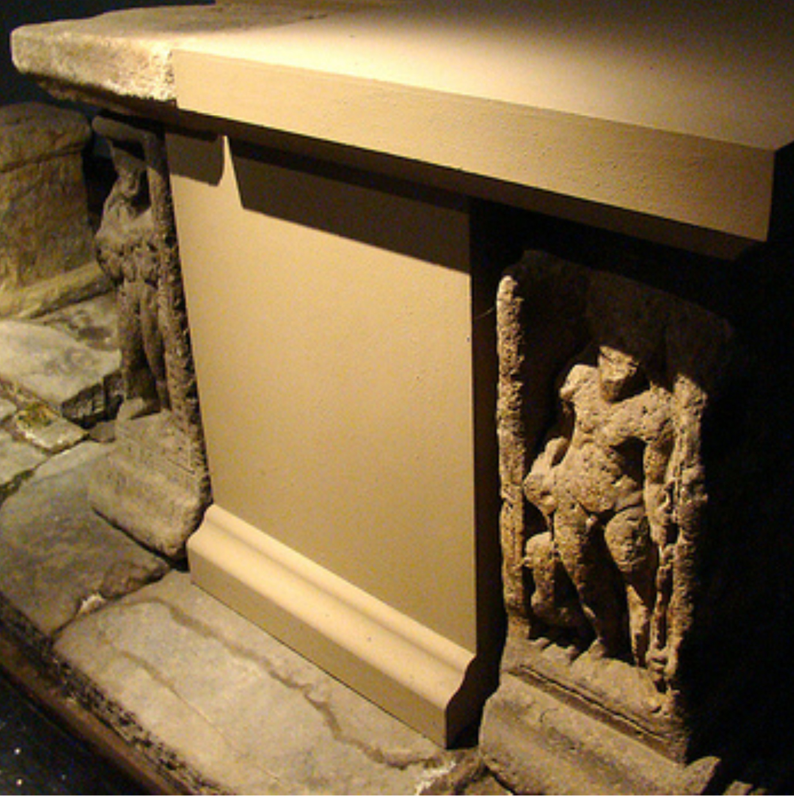
The main sacrificial altar was in front of the temple in the open air,
following the Roman custom.
The surviving elements of the altar – preserved in situ in the museum –
depict Bacchus, ?Venus, Jupiter and Hercules Bibax, illustrating the Roman practice of including a variety of gods within a sacred precinct.

Slide 13
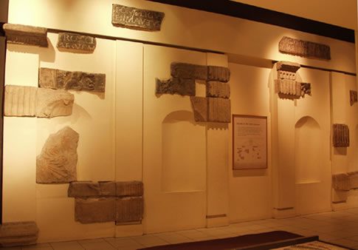
Another building stood facing the sacred spring.
Its pedimental sculpture has the disc of the full moon surrounding the head of the goddess Luna and you can see the whip she used for driving her horses.
These 21 fragments make up its façade with cupids in various roles depicting the Four Seasons.
The building opposite, over the sacred spring, was topped by a carving of the Sun god.

Slide 14
As well as offering dedications to gods, many people wanted to record their names on the buildings around the sacred spring …

Slide 15
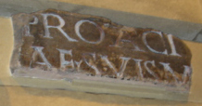
The names Claudius Ligur and Gaius Protacius can be deciphered on this building, along with a Guild or trade union of some kind and a reference to the building being repaired and repainted at their own cost.
They were decuriones - members of the ‘Ordo’ or Town Council, and it was part of their civic duty to contribute to the public building programme of their town.
So these Romano-British men had become members of a Roman-type Town Council rather than thinking of themselves as Celtic tribesmen.
All town councillors were given the status of Augustales (priests of the ‘Emperor cult’). As part of their duties they also had to take part in ceremonies worshipping the divinity of the Emperor.

Slide 16
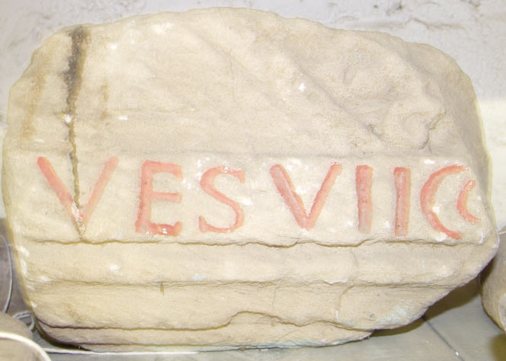
Roman Emperors associated themselves with the Baths at Aquae Sulis from the very beginning.
Vespasian, who was one of Claudius’s generals during the invasion of Britain in
43 A.D. and became Emperor in 69A.D. is commemorated on this stone: VES
VII C tells us that it was carved in 76AD – during Vespasian’s 7th year of holding the office of Consul – and it shows that he initiated the first phase of building.
But the Romans realised that the association of Emperors with religion could be inflammatory: during the Boudican rebellion in 60 – 61 AD the temple to Claudius in Colchester had been the focus of the Britons’ anger.

Slide 17
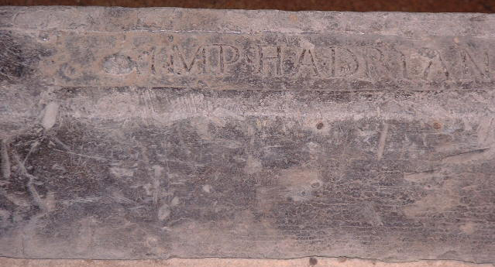
All the precious metals and mines in the Empire belonged to the Emperor.
The stamp on this lead ingot, or ‘pig’, shows that the Emperor Hadrian had sanctioned the use of vast quantities of lead for all the pipe-work needed for such a great building project.

Slide 18
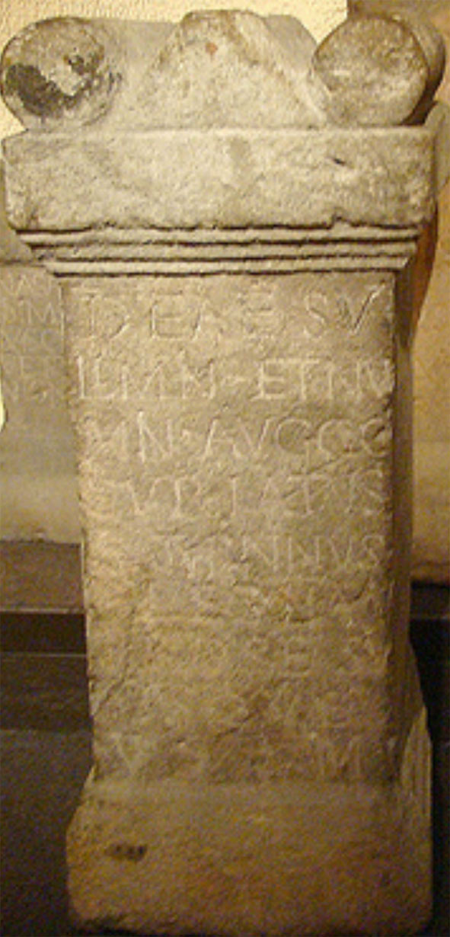
This altar is dedicated to Sulis Minerva and the Divinities of two Emperors.
Marcus Aurelius shared the title ‘Augustus’ with his brother Lucius Verus from 161 – 169 A.D.
Gaius Curiatius Saturninus, a centurion (>) of the 2nd Legion dedicated this votive altar.
Notice the formula VSLM again:
‘Happily and deservedly
kept his promise’.
This stone is therefore a mixture of Roman and Celtic religions
– and politics!

Slide 19
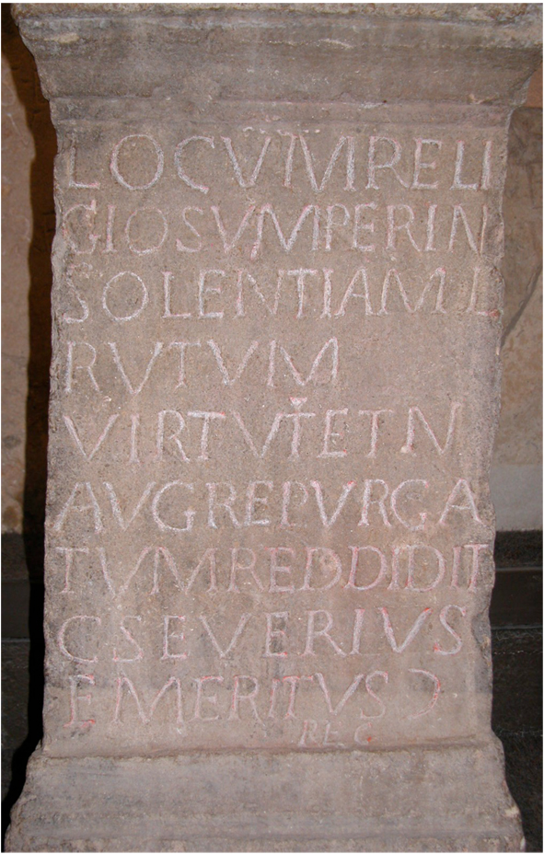
The Virtue and Deity of the Emperor (AVGustus)
is what this stone is dedicated to. (lines 5-6)
Gaius Severius Emeritus (final 2 lines), the centurion in charge of the area, has restored ‘this holy site’
(LOCUM RELIGIOSUM) (lines 1-2)
We do not know which Emperor it was, but it seems that someone (perhaps Christians?) had caused damage by vandalism
(PER INSOLENTIAM).

Slide 20
So how happy do you think the original Celtic Britons were with how the Romans changed the way they worshipped and lived in their new town of Aquae Sulis?

Slide 21
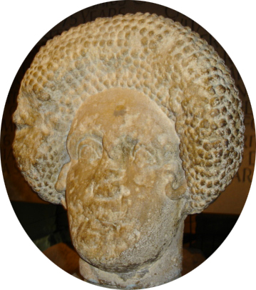
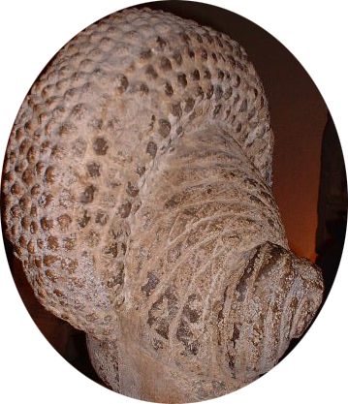
So how happy do you think the original Celtic Britons were with how the Romans changed the way they worshipped and lived in their new town of Aquae Sulis?
The late 1st Century AD hairstyle gives us a date for this sculpture of a woman’s head, which might have decorated a tomb.
We have no way of knowing whether this lady came from a British family but from the number of Roman-style combs, hair-pins and jewellery found in Roman Britain it is safe enough to assume that this is how wealthy Romano-British women at the time wanted to look, following Flavian Roman fashions!

Slide 22
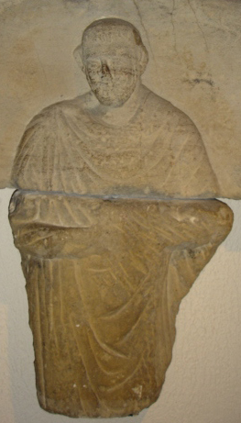
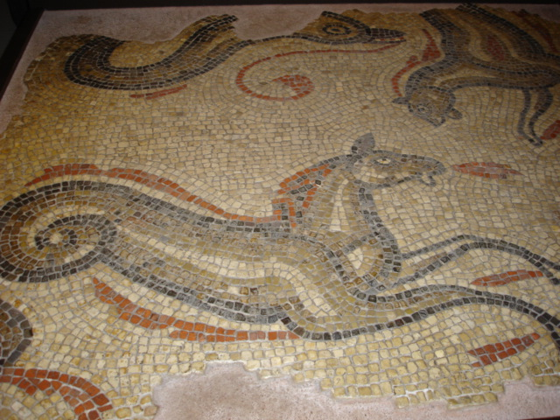
The Roman writer Tacitus records that his father-in-law Agricola, during his time as Governor of the province of Britannia, encouraged the Britons to want to speak Latin and to wear the toga, as well as living in centrally-heated houses with all the amenities of town life.
Again, we do not know the ethnic background of this toga-wearing man but he was obviously happy to have his memorial here. He would have been wealthy enough to have had his ashes sent elsewhere if he did not regard Aquae Sulis as his home.

Slide 23
Tacitus had a fairly cynical view of how the Romans manipulated the feelings of the people in their Empire. Writing in AD 98, he says:
The people of Britain were gradually led into the temptations of public buildings, baths and luxurious banquets, taking away all their enthusiasm for rebellion. The unsuspecting Britons talked about things like this as aspects of ‘civilisation’, whereas really they were just a feature of their enslavement.
Translation: Anne Dicks 2011
We do not have to be as cynical as Tacitus, but this was obviously the way to win the hearts and minds of the Britons, and it shows why the Roman Empire was so successful and lasted for so long!
Aquae Sulis, an important religious centre for all and named after the local Celtic goddess, contributed in no small way to the Romanisation of the whole province.

Slide 24
Identification of artefacts on Gods and Goddesses worksheet.
1st column
Minerva, goddess of Wisdom and crafts
Mother Goddesses
The hand of Jupiter, Roman King of the Gods, holding a thunderbolt
A hound looking at Diana, goddess of hunting
2nd column
Sulis Minerva and the divinities of two Emperors
The Suleviae (Germanic name for mother goddesses)
Loucetius Mars and Nemetona (Celtic/Roman fusion of god, and a Celtic goddess. Mars is the Roman god of War.)
Sulis Minerva
3rd column
Luna on pedimental sculpture. She is the goddess of the moon, sometimes associated with Diana.
Celtic goddess Rosmerta with Roman god Mercury.
Beneath them are a sacred animal or sacrifice and three Genii Cucullati, the little hooded figures.

Slide 25
Roman religion : lots of evidence, both written and sculptural.
N.B. Most of the gods in the traditional Roman pantheon were associated with Greek deities and shared the Greek mythological tradition.
Jupiter, King of Gods, associated with a thunderbolt; Juno, Minerva, Apollo, Venus, Diana, goddess of hunting, also known as Luna, the Moon goddess; Mercury, god of Trade and also the messenger of the gods; Mars, god of War, Aesculapius god of healing. Neptune was god of the sea, but there was a minor god called Triton who is often depicted using a shell as a musical instrument.
Romans liked the people in their Empire to worship the ’numen’ or divinity of their Emperors and to acknowledge their deification after death. This was a civic duty as well as a religious one.
They also worshipped personifications: e.g. Virtue, Health, Duty.
Temples : based on Greek temples, with
- impressive triangular ‘pediments’ at the front, with intricate relief sculpture carefully designed to fit the shape and formal motifs like circlets of leaves.
- huge pillars topped with finely decorated ‘Capitals’
Sculptures could be 3-D or relief carvings on a flat backgound.
The style was sophisticated and lifelike.
Ceremonies took place outside the temple, sometimes sacrificing animals.
A Haruspex would look at the internal organs of these animals to interpret the wishes and predictions of the gods.
People asked the gods to help them and promised to give them presents in return : that is why there are lots of inscribed ‘votive’ altars and offerings of all kinds at sacred sites.
See the Decoding leaflet, the Webpage and other resources for help with understanding these inscriptions.
Sometimes the gods were asked to punish people and that is why curse tablets are often found at religious sites. Many of these have been found in the sacred spring, written in a cursive script and often with each word written backwards.
See the interactive Museum displays to understand these better.
Minerva (Like the Greek goddess Athena) Goddess of War, Wisdom and hot springs. Her symbol was an owl, and a banded globe also signifies wisdom.
When Medusa, the snaky-haired gorgon, had been killed by Perseus, he cut off her head and took it to Athena, who put it onto her own armour.
One of her names is Nike (Victory), often shown as a winged goddess. INFORMATION SHEET TO BE PRINTED AND DISTRIBUTED
Celtic religion : hardly any evidence from before Roman times. All our written evidence is from the Romans!
Various Celtic gods, some of whose names we are not sure of:
Sulis, Nemetona, Rosmerta (often depicted holding a bucket-like container and accompanying the Roman god Mercury), Loucetius, Lenus, Ancamma.
3 Mother goddesses, called Suleviae in parts of Germany.
3 ‘Genii Cucullati’ – little hooded figures wearing a type of cloak which was apparently made in Britain.
The Celts may have worshipped heads. Several carved heads have been found but they may not have been made before Roman times.
They may also have worshipped the power of animals.
They had no temples, preferring to worship at sacred places, like hot springs.
We know very little about their priests called Druids, but the Romans exterminated them and wrote damaging propaganda about them which is unlikely to be true. Druids used to inspire respect and nationalistic feelings and would not contribute to the Romanisation of religion.
They did not make representations of their gods until Roman times, when they started to make little altars with relief sculptures on them.
Male gods were often shown with horns on their head, presumably to emphasise their power. From other artefacts we have (such as weapons and jewellery) we know that the Celts liked to incorporate beautiful swirling patterns into their art, making stylised patterns rather than lifelike images.
Sulis - the Celtic name for the goddess worshipped at Bath.
If the main Celtic deity at Bath had been a god called Sul, perhaps ‘Sulis’ can mean ‘daughter of Sul’. We don’t know.
As Roman Britain was a multicultural society, it is very difficult to know which gods originated in Britain and which came from other areas.
Other religions : Roman soldiers came from all parts of the Empire and would bring their own gods with them – eg. the Egyptian goddess Isis and the Persian god Mithras, a favourite god of soldiers. Christianity was not tolerated by the Romans because Christians refused to
acknowledge other gods or worship the Emperor as a god ( – treason!) until it was made the official religion of the Empire in the 4th Century.

